Slide 1

Project 0: Library Management System
A Revature Training Presentation
By Benjamin Tuley
23 December 2025
Notes:
Good Morning.
I chose to make a Library Management System for my project 0.

Slide 2
Design Requirements
Console Based
Written in Java
Persistence
Separation of Concerns
Notes:
When thinking of my project, I started by focusing on meeting the design requirements.
- It was written in Java using Intellij
- I used the scanner functionality to make it Console Based
I used docker and PostgreSQL to keep the data persistent
I used the 3-tier structure to ensure separation of concerns

Slide 3
Desired Functionality
Three different entities implementing CRUD
Members
Books
Loans
Notes:
I wanted the user to be able to create, read, update, and delete all of the relevant entities.
Members represent people who can check out book
Books represents the library’s current catalog
And Loans to track which members borrow which books

Slide 4
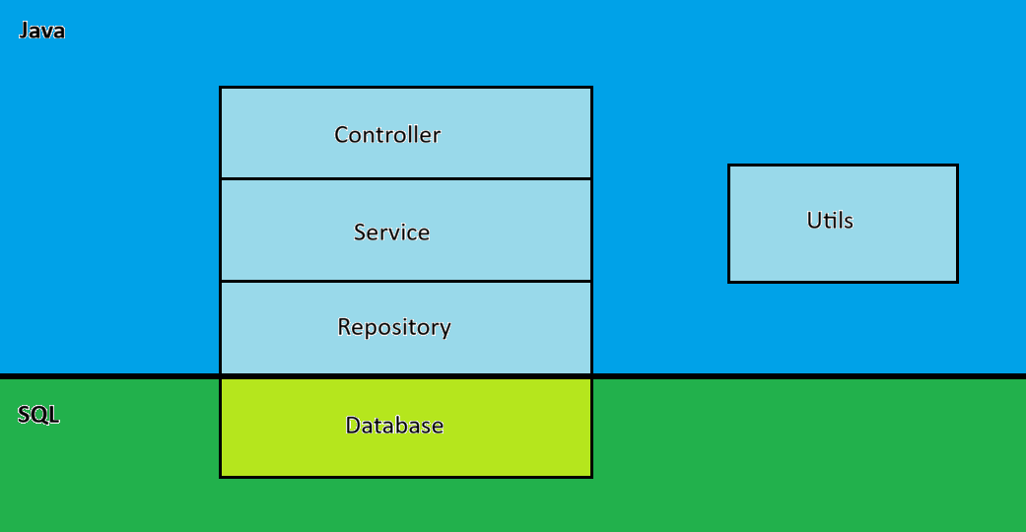
Project Structure
Notes:
The project was split between several layers
The controller layer for the user facing menus and input
The service layer for the business logic
The repository for communicating with the database
And the database itself
There is also a Util package to handle some validation as well as the global scanner and JDBC objects

Slide 5
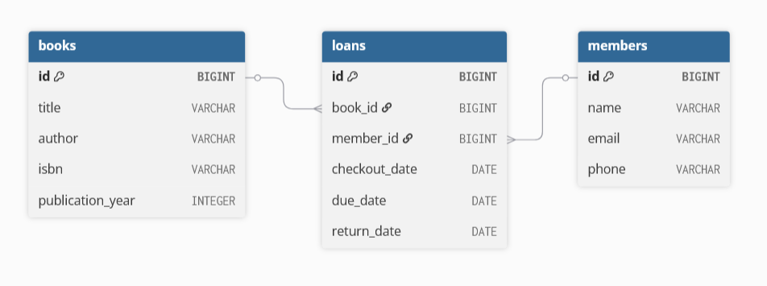
Database Structure
Notes:
The SQL database meets the requirements by
Having a many to many relationship between members and books
Loans is a bridge table for this relationship
It is in 3NF because each table represents a single entity, all non-key attributes depend only on the table’s primary key, and there are no transitive dependencies—relationships between books and members are handled exclusively through the loans table using foreign keys.

Slide 6
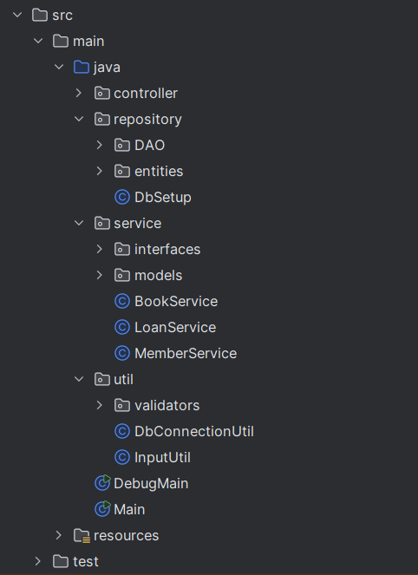
Java Structure
Notes:
This is the basic implementation of the 3-tier structure in Java with some of the package details hidden.

Slide 7
Application Demo

Slide 8
Thank you
Benjamin Tuley
benjamin201@revature.net
https://github.com/XenonReaction/Project_0-Library_Management_System
Notes:
https://github.com/XenonReaction/Project_0-Library_Management_System

